Slide 1



Energy Distribution of Cosmic Rays in ERAU Prescott
[1]Physics and Astronomy Department / College of Arts and Sciences
[2] Electrical, Computer, and Software Engineering/ College of Engineering
Blake Schuetz [1] | Lucas Murphy [1]| Gary Wiens [2] | Gabriella Keane[1] Dr. Darrel Smith [1]

Slide 2
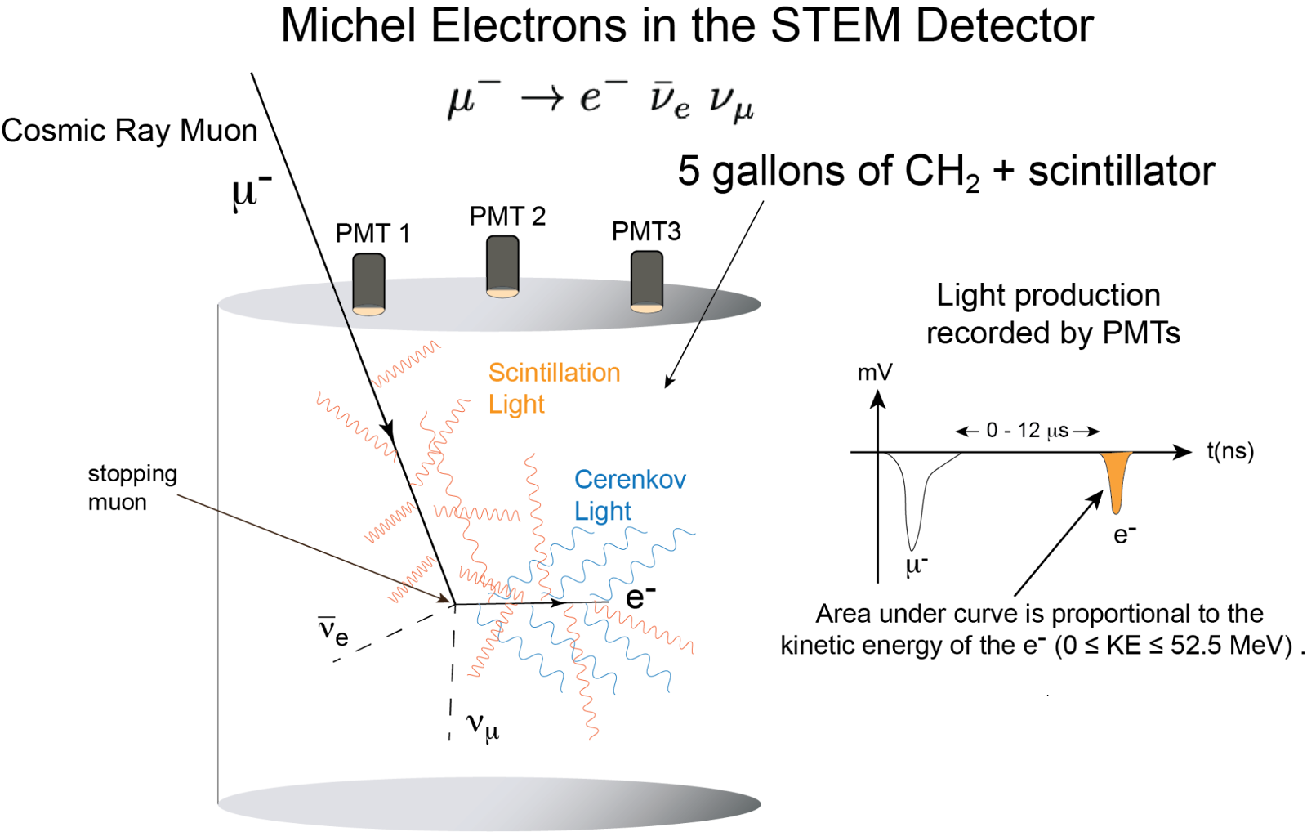
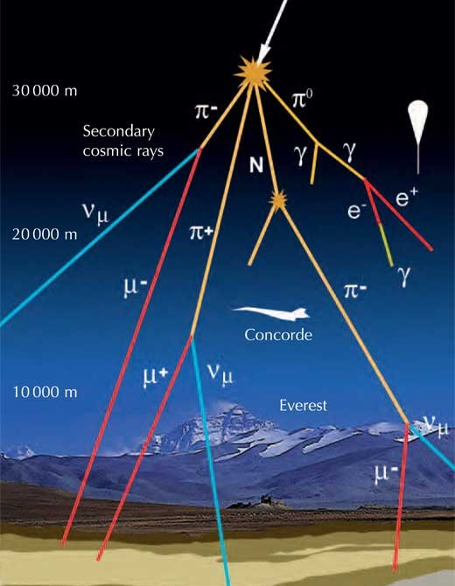
Use of Liquid Detectors for Particle Interactions
Large liquid detectors (water, mineral oil, liquid argon, etc.) are designed to detect rare particle interaction events
Cosmic ray interactions in the atmosphere produce a shower of particles including muons (μ⁻)
Particle interactions produce scintillation light (isotropic) and Cherenkov light (directional)
The amount of light correlates to kinetic energy of the particles
North-Holland, 1993; Nuclear Instruments and Methods in Physics Research Section A; Accelerators, Spectrometers, Detectors and Associated Equipment, Volume 501, Issues 2-3, Pages 418-462, 1 April 2003 & 1 February 2009; Physical Review D Vol, 106, No.1, 2022
Figure 1a: Concept Diagram for 5-Gallon Scintillator
Figure 1b: Cosmic ray interactions in the atmosphere
Notes:
Full text slide

Slide 3
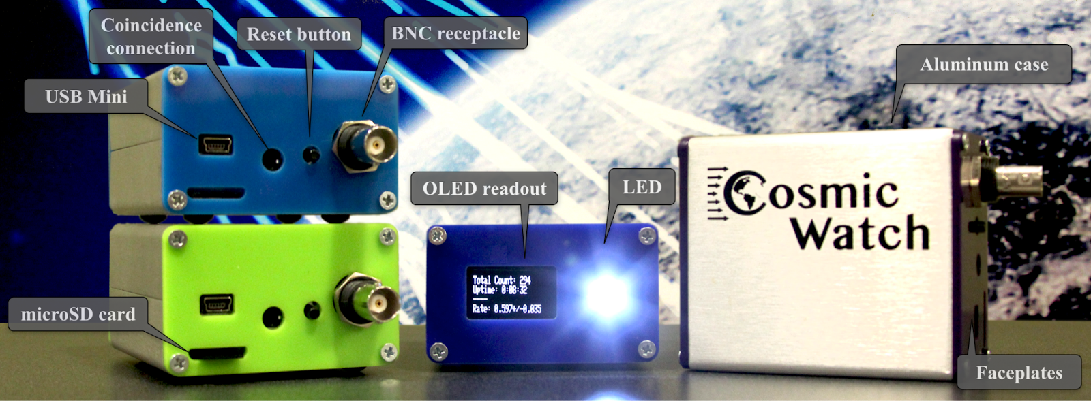
Cosmic Watch Detectors
Figure 2: Cosmic Watch Detectors Model Image
Notes:
General introduction slide

Slide 4
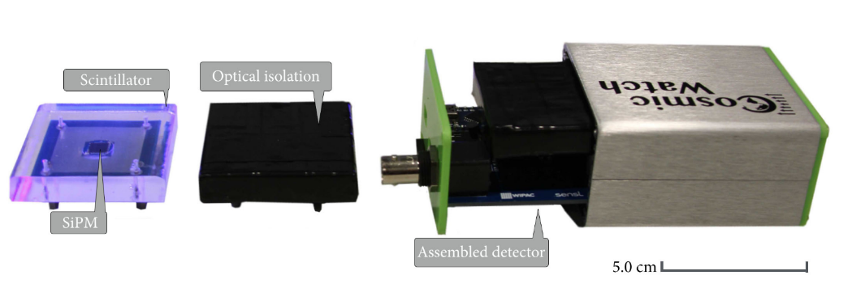
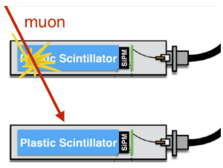
Cosmic Watch Detector Plans for the Year
Assemble 4 Cosmic Watch Detectors (CWDs)
Have two pairs of CWDs in sequence to reduce background and measure directional information
Collect energy calibration data and event triggers
Create a model for other universities engaging in dark matter research
CosmicWatch, (c)2017 P. Przewłocki & K. Frankiewicz.
Axani, The Physics Behind the CosmicWatch Desktop Muon Detectors, 2018
Figure 3a: Cosmic Watch Detectors in sequence
Figure 3b: Cosmic Watch Detector internal components
Notes:
General introduction slide

Slide 5
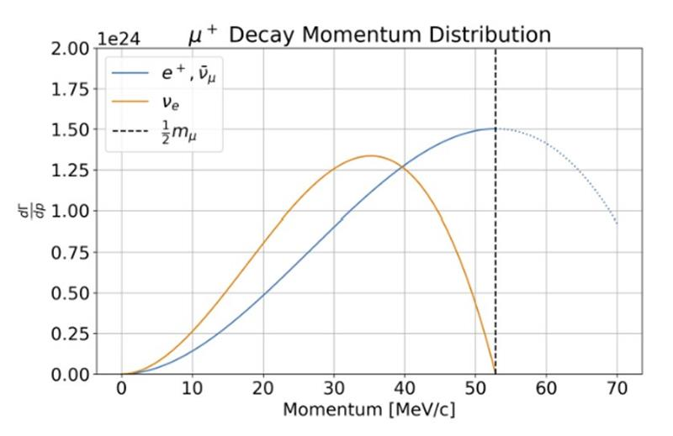
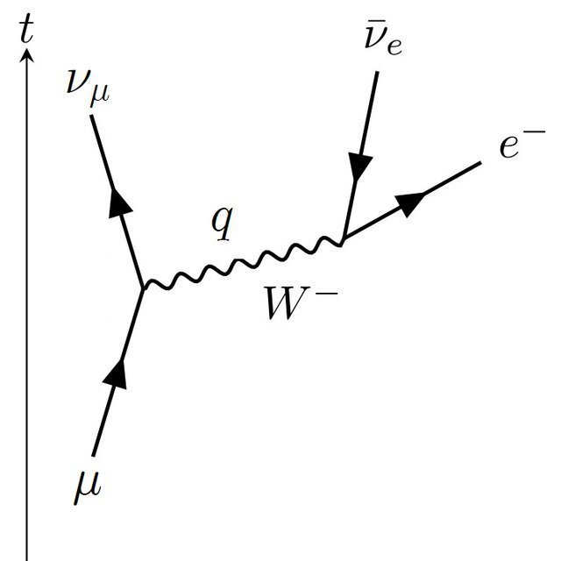
Cosmic Watch Detector Plans for the Year Cont.
Produce KE distribution of Michel electrons near the center of the detector
Compare to theoretical distributions to determine energy calibration upper limit
Set new limits to mass in dark matter searches using CCM detector at Los Alamos Neutron Science Center (LANSCE)
Axani, American Journal of Physics 85, 948-958, 2017
Figure 4a: Feynman Diagram of muon decay
Figure 4b: Theoretical Michel Electron Energy Distribution
Notes:
Full text slide

Slide 6
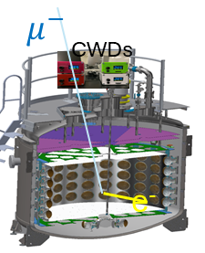
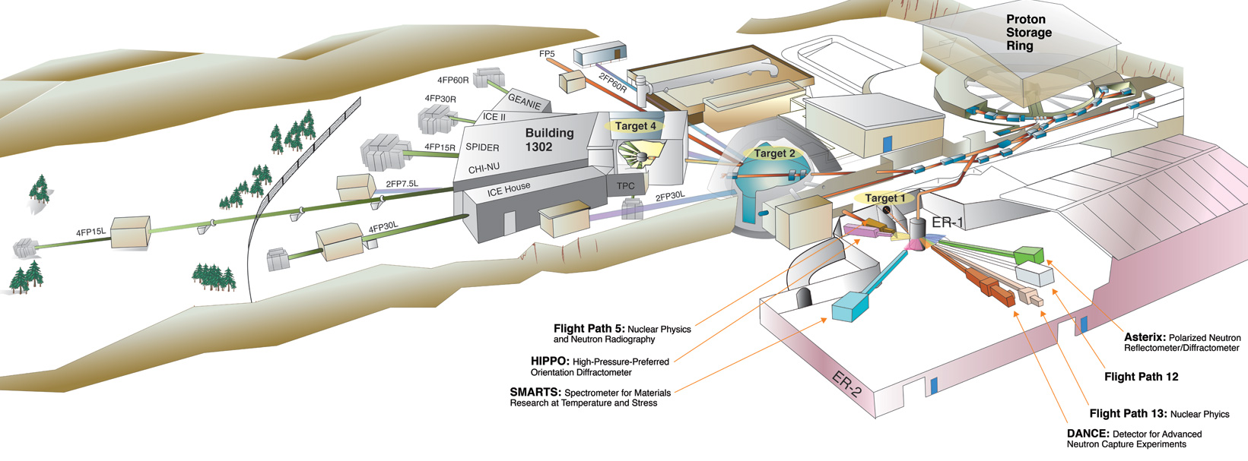
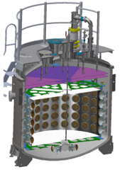
Coherent CAPTAIN-Mills Experiment
Figure 5a: Coherent CAPTAIN-Mills Experiment (cutaway)
Figure 5b: Los Alamos National Laboratory (with CCM Detector)
Notes:
General introduction slide

Slide 7
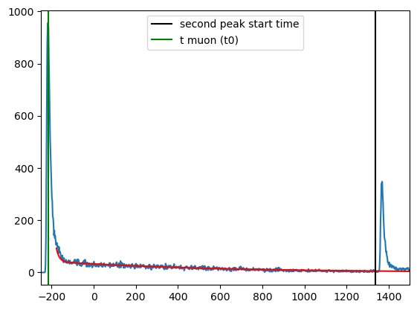
Future Applications for CWDs at ERAU Prescott
Measure Michel electron KE spectrum for calibrations
Study flux and energy distributions of cosmic rays at 34.54° latitude
Analyze cosmic ray intensity as a function of incoming angle
PE (photoelectrons)
Time (ns)
Figure 6: Michel Electron KE Spectrum
Notes:
Full text slide

